Slide 1
Analysis of mobile application A/B test results
Done: Vladislav Goncharuk
Goal: Determine whether a "50% off" indication affects subscription conversions.
Tools: Python (pandas, scipy, seaborn, matplotlib)
Project done in course Data Analytics from GoIT School

Slide 2
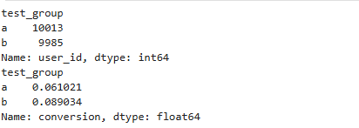
Data description
Group | Users | Conversion
A | 10 013 | 6.10%
B | 9 985 | 8.90%
Data:
One row= one user
Fields: user_id, test_group (a/b), conversion (0/1),
event_time
Goal: Compare conversion
(install → purchase) between groups
Data quality check:
No empty values
Unique users: 19 998
Test start: 03.07.2023
Test end: 25.07.2023
Duration: 23 days

Slide 3
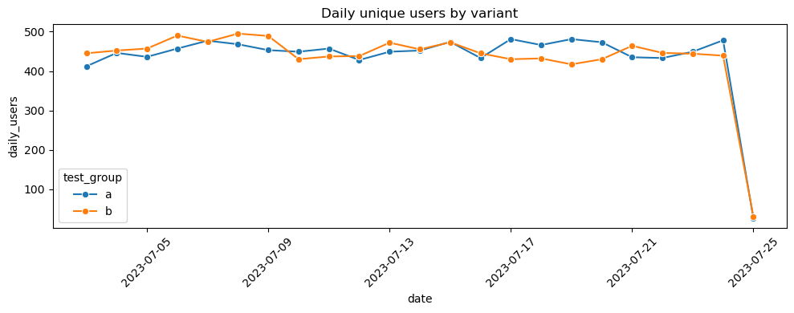
User dynamics
Conclusion:Traffic is stable, no anomalies observed.
On chart: Axis X — date, Axis Y — daily users count
The line graph shows the number of unique users by day for groups A and B.

Slide 4
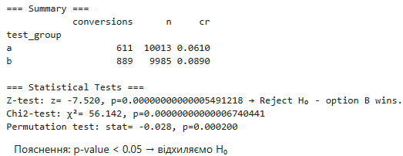
Statistical analysis
Method: Since the metric is binary (conversion), a z-test for two options was applied,
χ²-test and permutation test.
α - 5%
Test results:
Conversion in group B is
statistically significantly
higher than in group A.
Test | Statistic | p-value | Conclusion
Z-test | –7.52 | 0.0000000000000549 | Reject H₀
χ²-test | 56.14 | 0.0000000000000674 | Reject H₀
Permutation | –0.028 | 0.0002 | Reject H₀

Slide 5
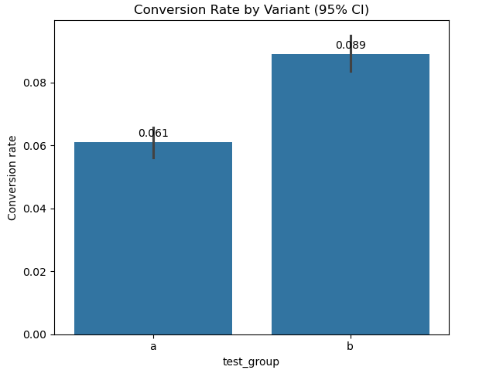

Conversion rate compare
Results:
absolute difference
Δ_abs (B–A) = +2.8 percentage points.
Relative growth (Uplift) = +45.9%
Graph with 95% confidence intervals - CR difference between A and B.

Slide 6
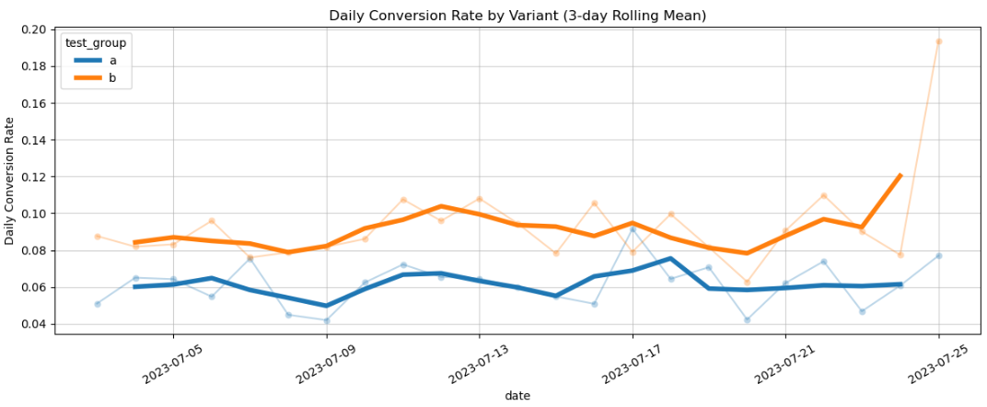
Conversion dynamics
Results: The effect is not random, the trend is consistent.
Conclusion: The chart of daily CR for each group demonstrates a stable, non-random advantage of Variant B throughout the entire testing period. Trend lines are also shown to smooth data variability.

Slide 7
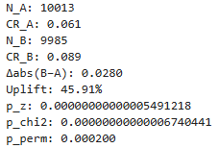
Recomendations
Results: The effect is not random, the trend is consistent.
Conclusion: The difference is statistically significant (p-value < 5%).
Recommendation: Implement a new design with a "50% discount" tag.
Additionally — check the impact on LTV and user churn.
Value | A | B
User count | 10 013 | 9 985
Conversion Rate | 6.10% | 8.90%
Δabs | +2.8 p.p.
Uplift | +45.9%

Slide 8



Thanks for attention!
Ready to cooperate
Contacts
Email LinkedIn GitHub

